Slide 1



BeautyGAN: Instance-level Facial Makeup Transfer with Deep Generative Adversarial Network
Tingting Li
Tsinghua-Berkeley Shenzhen Institute, Tsinghua University
Ruihe Qian
Institue of Information Engineering
of Chinese Academy of Sciences
Chao Dong
SIAT-Sensetime Joint Lab, Shenzhen
Institutes of Advanced Technology,
Chinese Academy of Sciences
Si Liu
Beijing Key Laboratory of Digital
Media, School of Computer Science
and Engineering, Beihang University
Qiong Yan
SenseTime Research
Wenwu Zhu
Tsinghua-Berkeley Shenzhen
Institute, Department of Computer
Science and Technology, Tsinghua
University
Liang Lin
Sun Yat-sen University, SenseTime Research

Slide 2


Motivation
Problem Definition: Facial Makeup Transfer
Makeup Transfer Network
non-makeup
reference
generated result
input
output
Current Approach
Our approach:
End-to-end unified training networks
Generate visually pleasant faces with accurate makeup transfer results
Deep localized makeup transfer network^{[1]}(state-of-the-art)
Adopt independent networks to process local cosmetics individually.
The results are unnatural with apparent artifacts at combining places.
CycleGAN^{[2]}
Domain-level image translation rather than instance-level translation.
Style transfer^{[3]}
Manipulate global styles like painting strokes while makeup is the combination of different local style/cosmetics, such as eye-shadow, lipsticks, foundations.
[1] Si Liu, Xinyu Ou, Ruihe Qian, Wei Wang, and Xiaochun Cao. 2016. Makeup like a superstar: deep localized makeup transfer network. AAAI Press, 2568–2575.
[2] Jun-Yan Zhu, Taesung Park, Phillip Isola, and Alexei A Efros. 2017. Unpaired image-to-image translation using cycle-consistent adversarial networks. arXiv preprint arXiv:1703.10593 (2017).
[3] Leon A Gatys, Alexander S Ecker, and Matthias Bethge. 2015. A neural algorithm of artistic style. arXiv preprint arXiv:1508.06576 (2015).

Slide 3
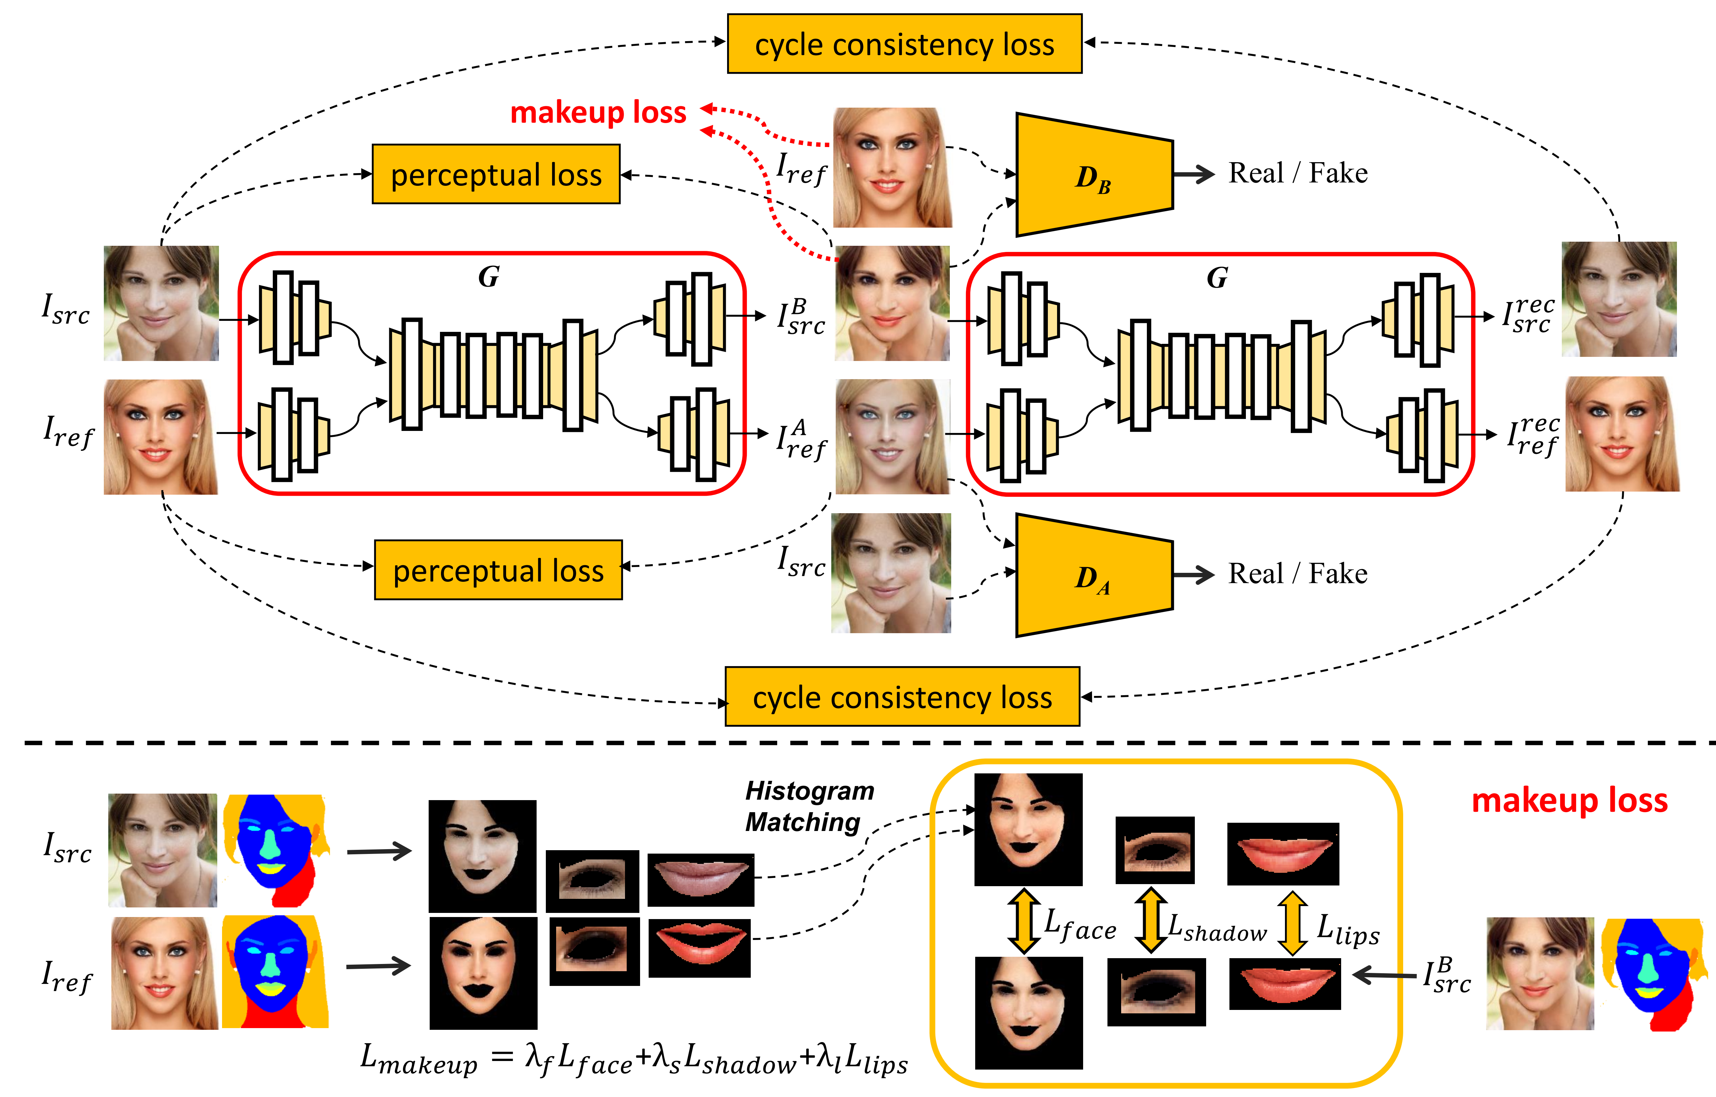
Our approach: BeautyGAN

Slide 4
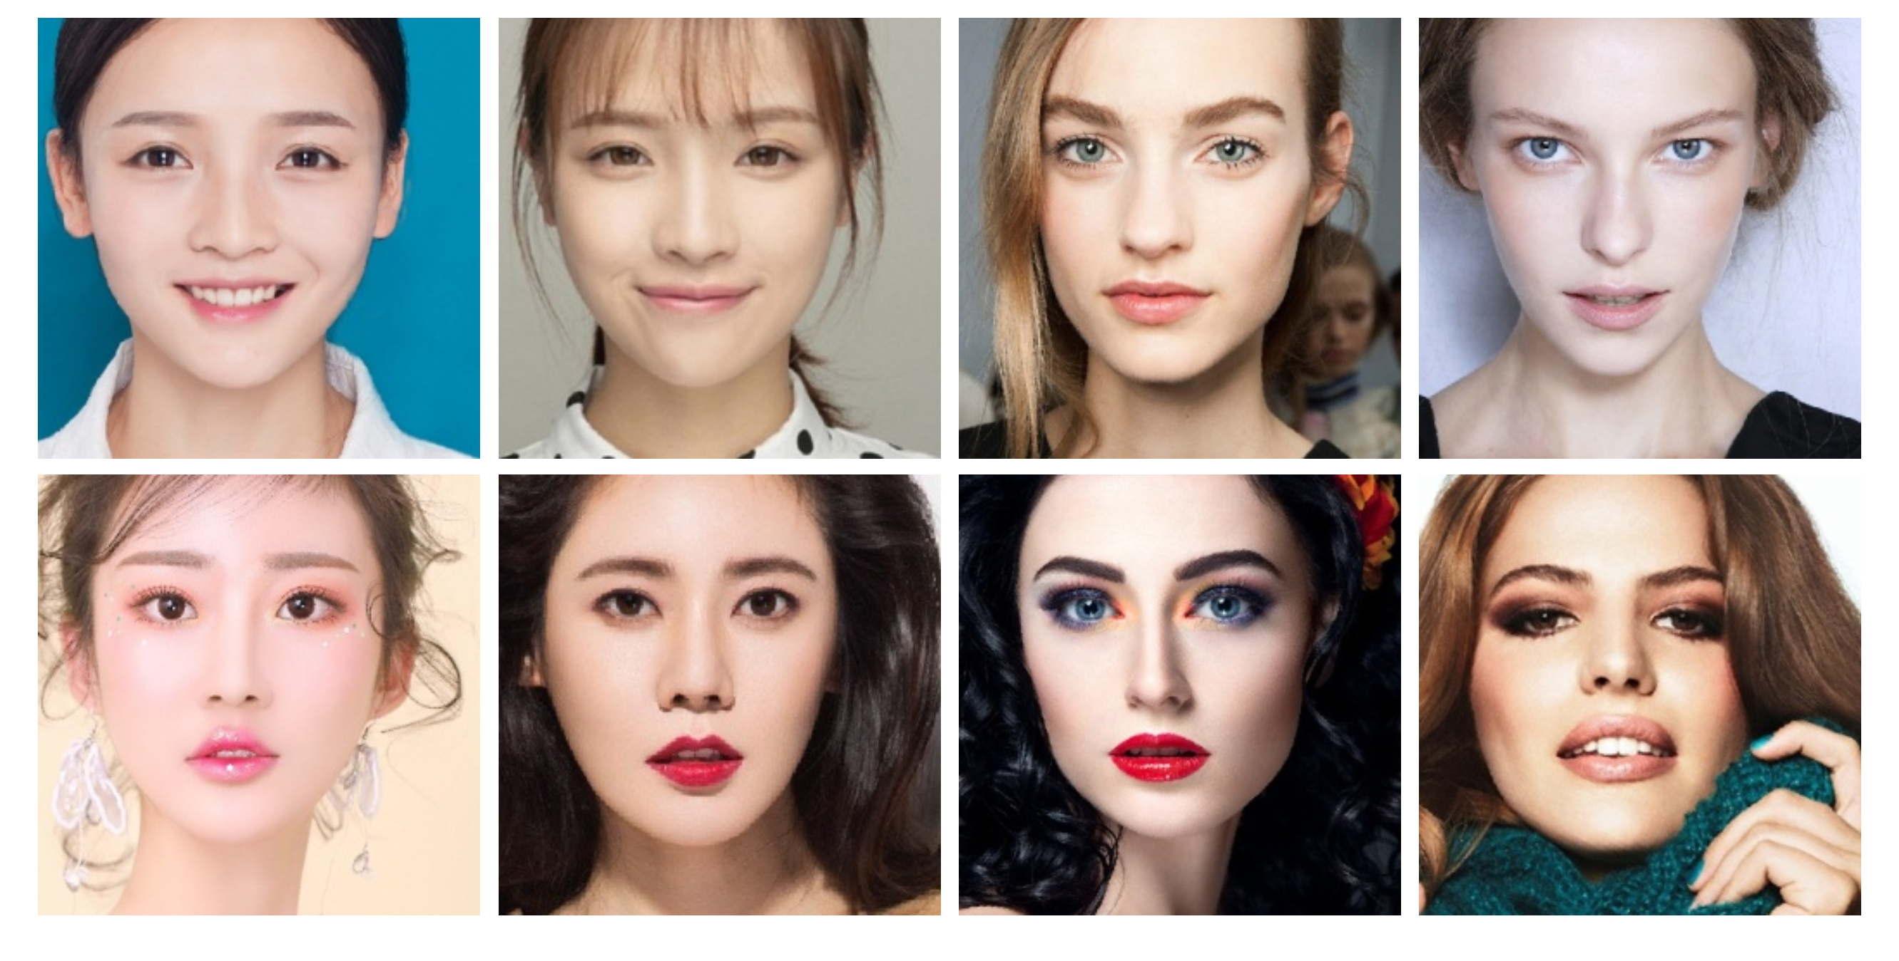
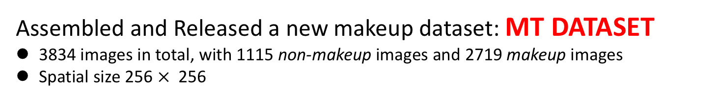
Data collection
Assembled and Released a new makeup dataset: MT DATASET
3834 images in total, with 1115 non-makeup images and 2719 makeup images
Spatial size 256 $×$256

Slide 5
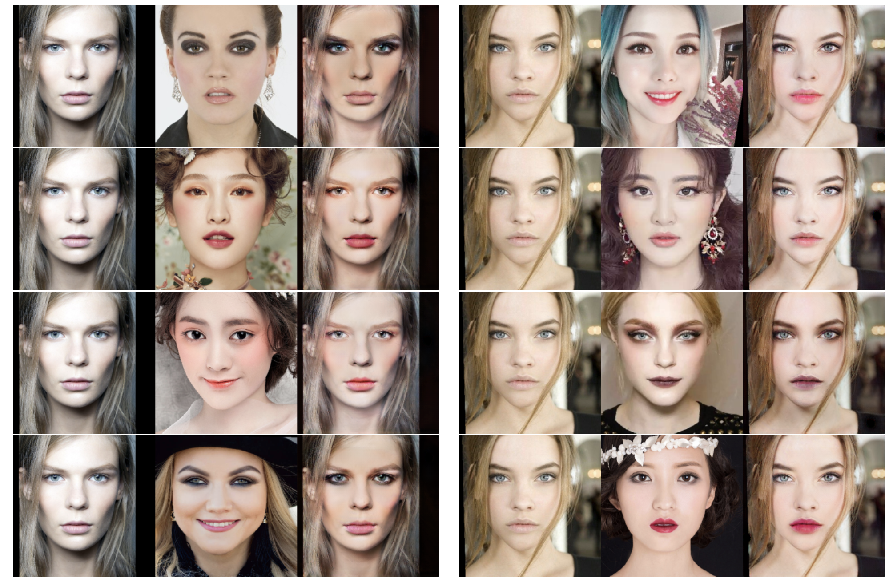
Experimental results
generated
result
generated
result
non-makeup
reference
non-makeup
reference

